Slide 1

Building event-driven cloud solutions with Microsoft Azure Event Grid Presented by Harris Kristanto & Nikolai Blackie @Adaptiv

Slide 2


About Harris
Developer/Support Analyst @ Adaptiv Integration
Hobbies: Photography and Powerlifting
http://www.adaptiv.co.nz/team-member/harris-kristanto/
https://www.linkedin.com/in/harris-kristanto-816a624b/

Slide 3

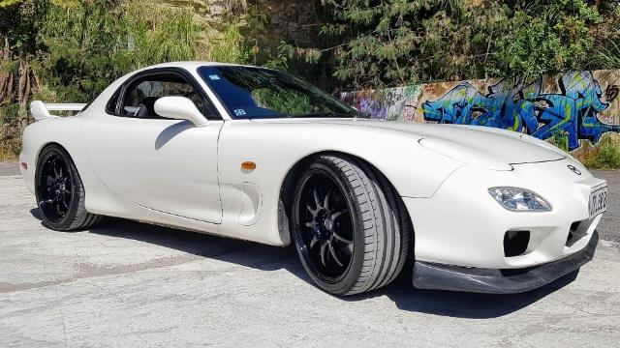
About Nikolai
Co-founder and Principal Architect @ Adaptiv Integration
Partners with Dell Boomi, Microsoft and MuleSoft
Hobbies: Cycling, Classic Cars, Rick & Morty!!!
http://www.adaptiv.co.nz/team-member/nikolai-blackie/
https://twitter.com/nikolaiblackie/
https://www.linkedin.com/in/nikolaiblackie/

Slide 4
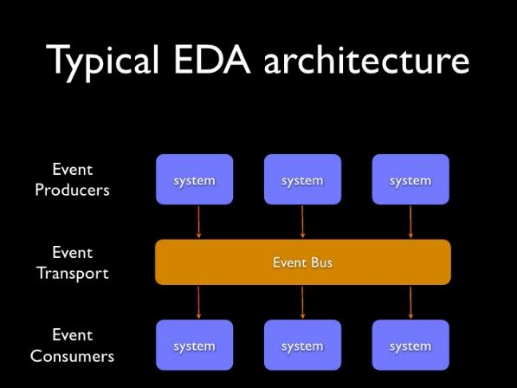
Event-driven architecture
“Events” refer to things that happen in the systems
They often do not carry much data with it
EDA promotes the detection, consumption of, and reaction to events, rather than actions
Notes:
Nikolai
What are events, what EDA is about
EDA vs. SOA
Lightweight events rather than service call contracts

Slide 5
Event-driven architecture
SOA relies on request/reply function to collect and react on data (polling?).
EDA provides the capabilities of SOA plus detecting and reacting to events.
Notes:
Nikolai

Slide 6
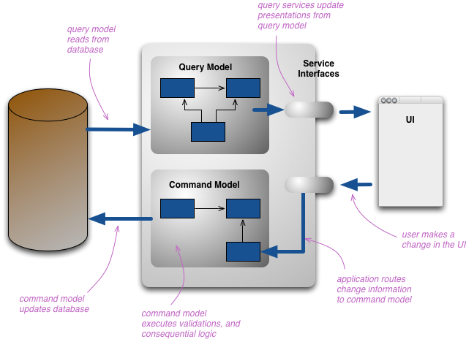
Command Query Responsibility Segregation
Keeping the model that we use to read information separate with the one to update information.
Benefit for handling high performance application.
The separation of loads from read and write allows us to independently scale.
Notes:
Nikolai

Slide 7
Event-driven architecture
Pros:
Decouples the event ‘Producers’ and ‘Consumers’
Eliminates the need for polling
Scalability
Redundancy
Resiliency
Cons:
Increased complexity
Overkill for simple systems
Notes:
Nikolai – hand over to Harris
Pros:
Asychronous communication — Processes writing and reading data execute independently of each other.
Requests are batched in real-time. Enqueuing requests is more efficient than spawning an individual execution for each real-time message
Decoupling — Producers and consumers of messages are independent and can evolve separately at their own rate. Workflow is encapsulated into logical, reusable units — that is, separate processes — which are organized, maintained and deployed independently.
Multiple recipients — Messages can be sent to multiple recipients independently. Likewise, their receipt can be monitored independently.
Redundancy — Message queues can persist messages until they are fully processed.
Resiliency — Decoupling implies failures are not linked, thereby mitigating the risk of unreliable applications. A producer can continue to enqueue messages while consumers are temporarily disabled.

Slide 8
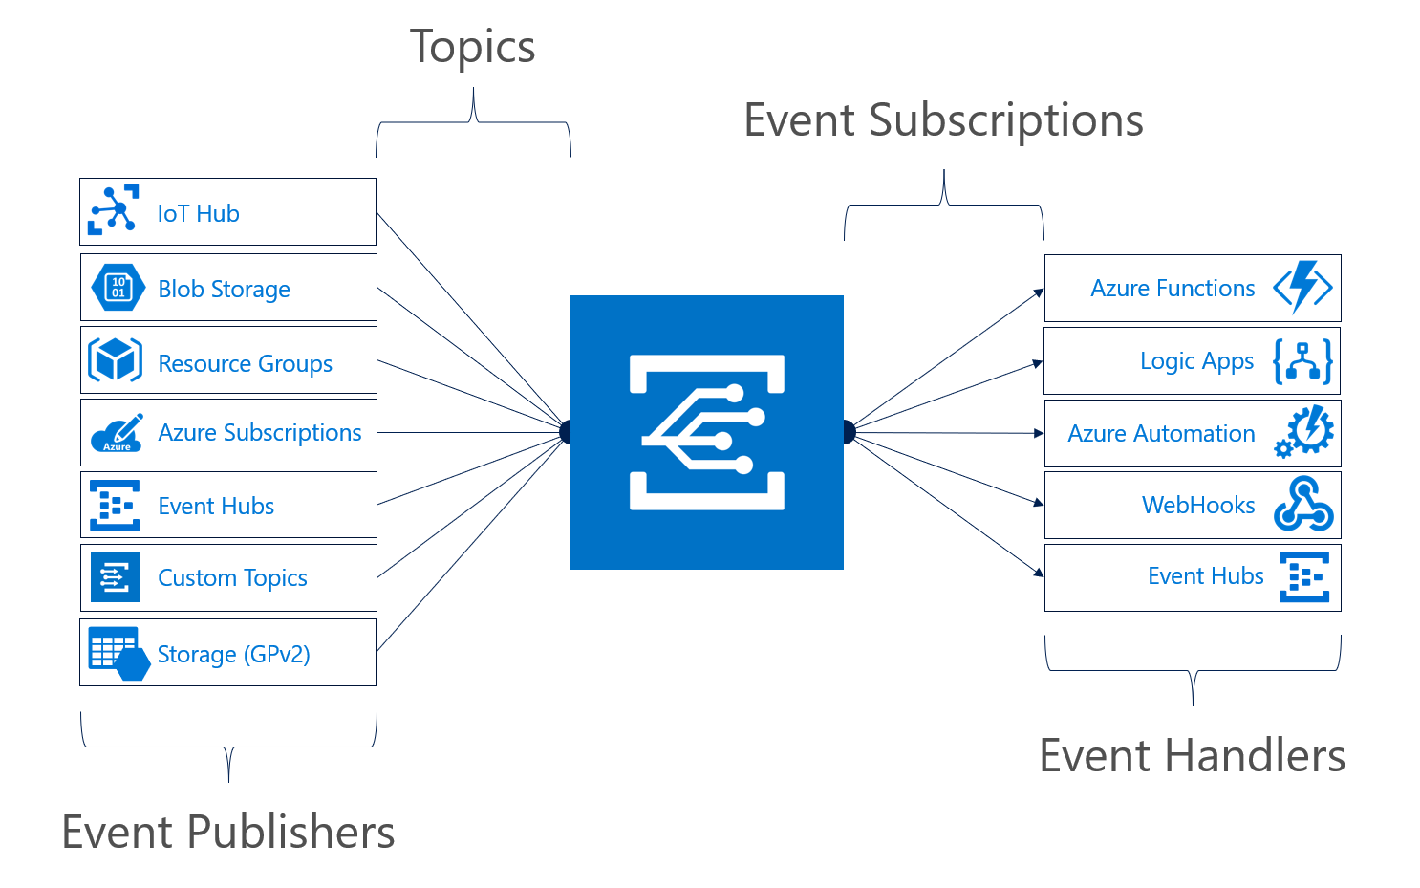
Azure Event Grid
Event based Router as a Service (EBRaaS)
Operates with Pub/Sub model, pushes events to registered subscribers

Slide 9
Event Grid, Event Hubs, Service Bus
Event Grid
Event distribution
Used to react on status changes
Event Hubs
Event streaming
Collect telemetry and distributed data
Handling big data
Service Bus
Send and process message
Ecommerce order processing and financial transactions
Supports deadletter, peek-lock

Slide 10
Why Event Grid
Scales up to 10,000,000 events per second
99.99% SLA
Integrates natively with Azure services
Technology agnostic (HTTP Protocol)

Slide 11
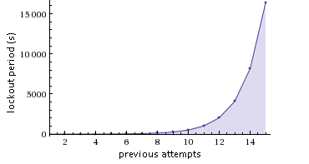
Retries and at least once delivery
24-hour retry with exponential back off for undelivered events
10 seconds
30 seconds
1 minute
5 minutes
10 minutes
30 minutes
1 hour

Slide 12
Use Case Scenarios
Operations
Serverless Applications
Systems Integration
IOT

Slide 13
Security
Webhook Validation
Management Access Control
Topic Publishing, SAS key on header
{"validationResponse":"3158cb2f-a2c4-46ca-96b0-ae2c8562fa43"}
Aeg-sas-key: Sbe2+g9Gju9s0+eWjDdyEc9tNEoOFXXGXG40fb2zgDQ=

Slide 14
Azure Resource Group Event Schemas
Notes:
Topic: Full resource path to the event source, provided by Event Grid

Slide 15
Pricing
$0.60 per million operations
Operations include:
Ingress events
Advanced matches
Delivery attempts
Management calls
100,000 free operations per month
Management operations throttled to 10 per second
1,000 event subscriptions per account
Operation definitions, number of free operations, management throttling, and number of subscriptions per account subject to change upon GA

Slide 16
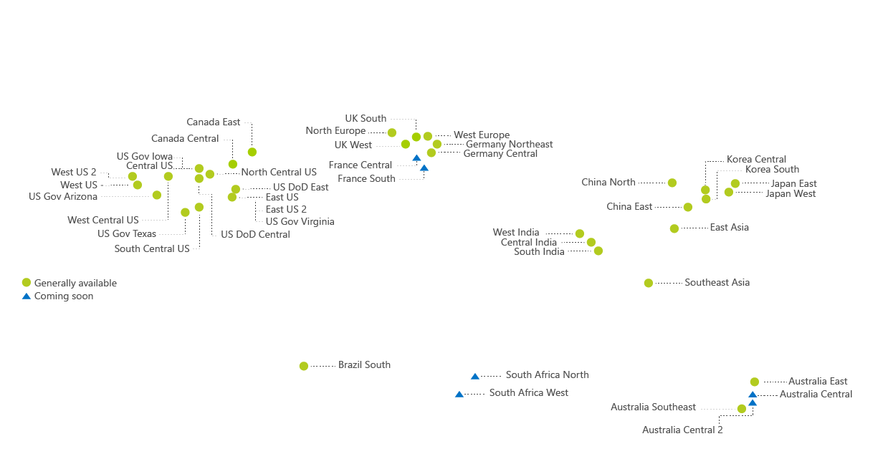

Where is it?
Notes:
West US, East US, West US 2, East US 2, West Central US, Central US, West Europe, North Europe, Southeast Asia, and East Asia with more coming soon.

Slide 17
Demo
Highly multitenant
Notes:
Animate section to guide your discussion
Think about why this is useful, what would you use it for and in what context.
System admin to monitor for changes
VM created, DB Deleted, Creation failed

Slide 18
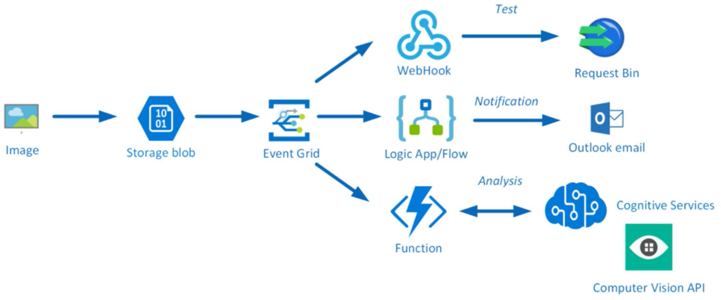
Labs

Slide 19



Reference material
https://martinfowler.com/articles/201701-event-driven.html
http://www.thedigitalbridges.com/event-driven-architecture-ai-cloud/
https://docs.microsoft.com/en-us/azure/event-grid/security-authentication
https://docs.microsoft.com/en-us/azure/event-grid/compare-messaging-services
Integration Down Under - Serverless Eventing with Azure Event Grid – Dan Toomey

Slide 20
Questions?

